Slide 1


Devpost - Google Cloud Vertex AI Agent Builder Hackathon 2024
Google Vertex AI Agent Builder
Development by Amit Gupta
& Yogesh Gupta
Project name : GoogleMediBuddy
Agent name : MediBuddy-Vertex-AI-Agent Builder

Slide 2
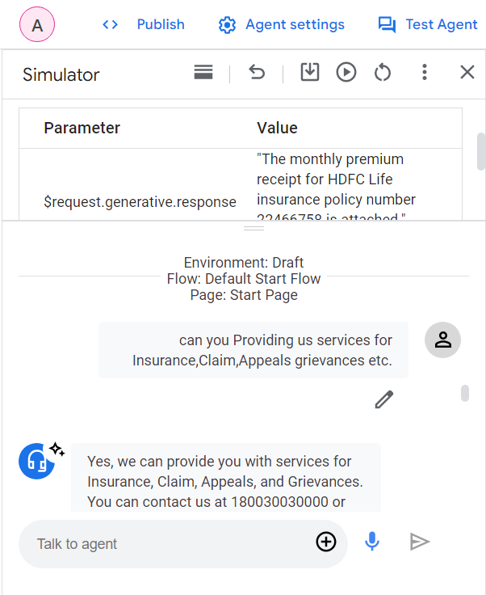
Idea Overview – Problem
Google AI BOT for this problem
Problems with Current State
Health Insurance is very necessary for every people but it is very costly. some of the people not able to take it because of their financial situations.
Other side most of the people whose is having insurance policy are facing problem of their insurance, claim approval etc.
Their Cost and time are wasted for these clarifications and communications.

Slide 3
Idea Overview – Potential Solution
Solution.
Building a Generative Google Vertex AI MediBuddy-Vertex-AI-Agent Builder under Project name "GoogleMediBuddy" Bot for Insurance,Claim etc details associated with a patient's care with help of Generative Google Vertex AI and custom dataset for training the Vertex-AI-Agent
Also created another Healthcare Assistant Agent with python based using Google Vertex AI Gemini API with LLM prompt Engineering .

Slide 4

Google MediBuddy-Vertex-AI-Agent Builder and Healthcare Assistant Agent - Benefits
1
Google MediBuddy-Vertex-AI-Agent builder is the Google AI based chat bot.
2
Google MediBuddy-Vertex-AI-Agent is providing the services for the insurance , claim , patient care etc . details.
3
MediBuddy-Vertex-AI-Agent Builder is trained based on our private custom training dataset along with the Generative Google Vertex AI LLM.
Healthcare Assistant Agent is the knowledgeable Health care bot based on Google Vertex AI Gemini API with LLM prompt Engineering.
4
Healthcare Assistant Agent is the knowledgeable Health care bot for providing the help for poor people who is not able to purchase insurance policy.
5
6
Healthcare Assistant Agent is also provide patient care support and services for A patient does not wish to travel and The patient does not have health insurance.
7
It can help for reducing the cost and time for govt, patient , provider and insurance claim company

Slide 5
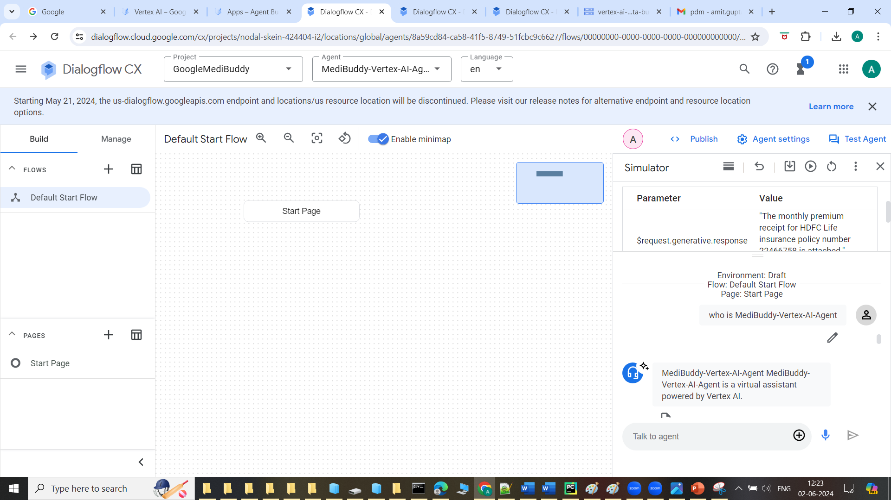
Images of MediBuddy-Vertex-AI-Agent Builder

Slide 6
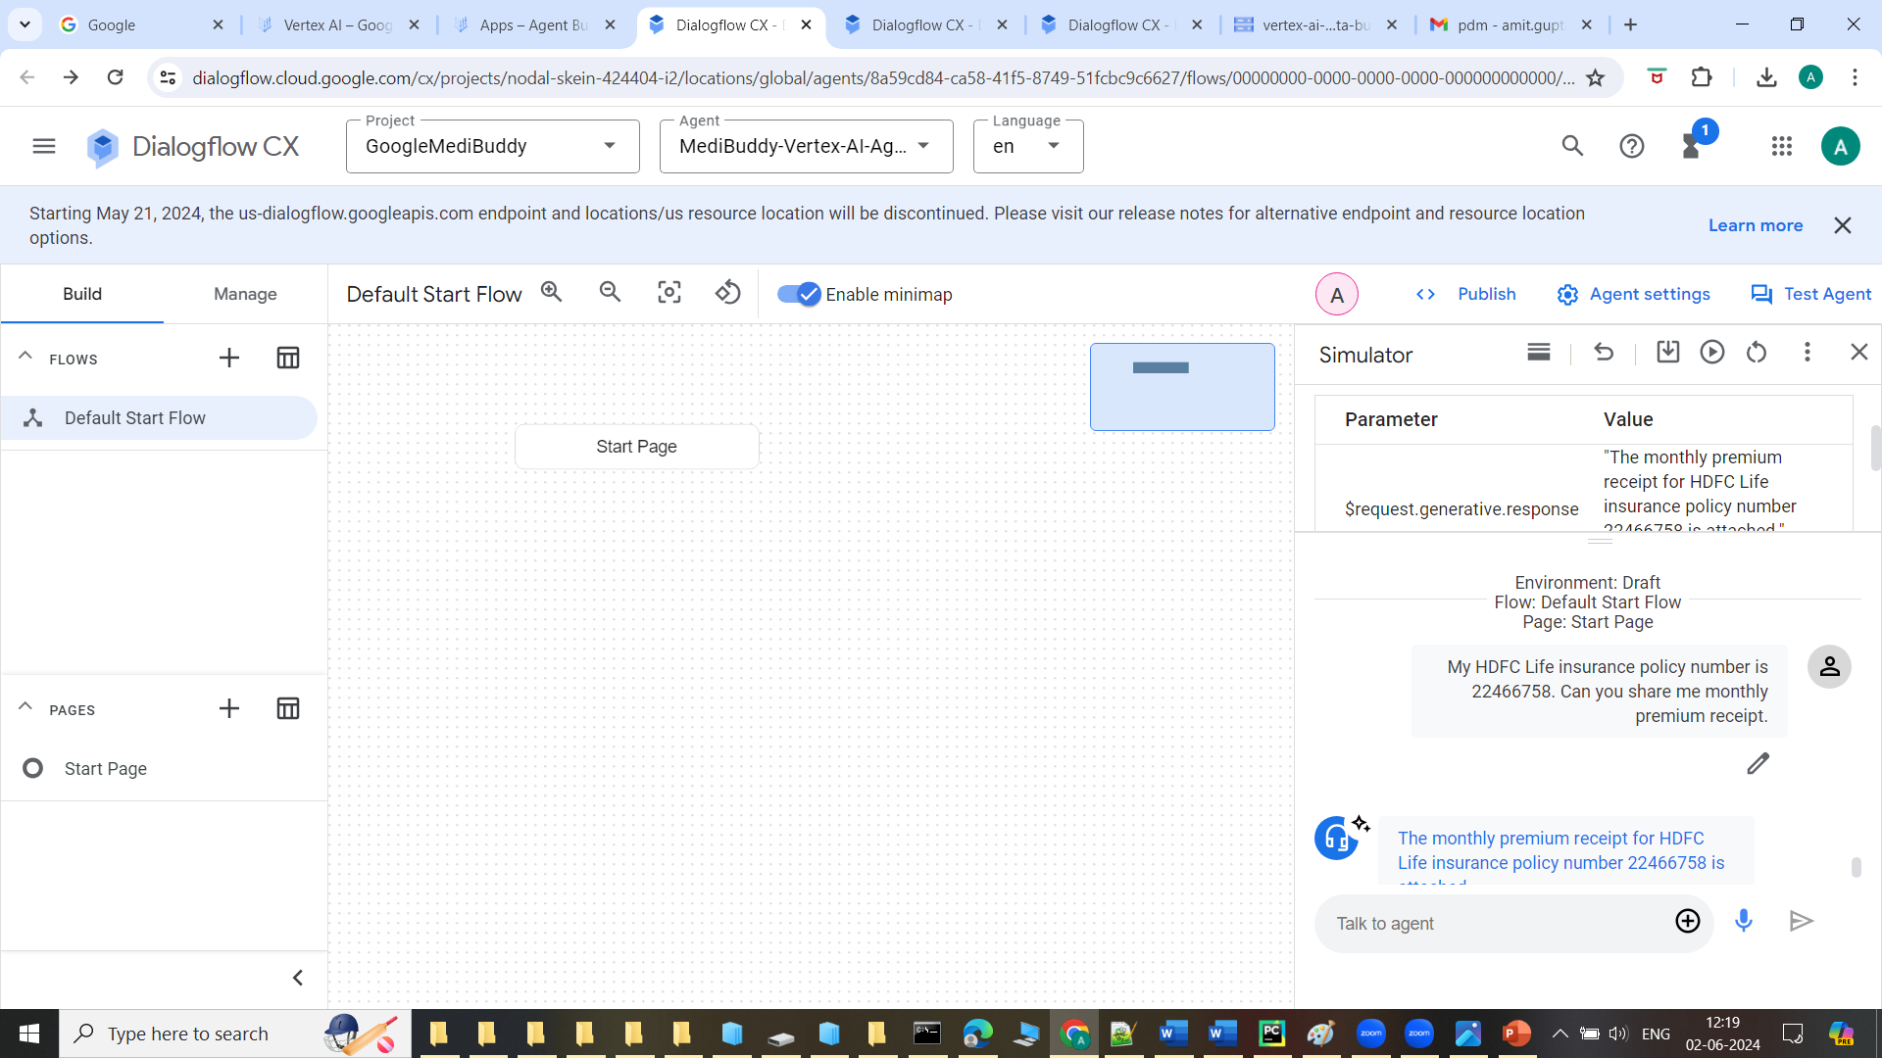
Images of MediBuddy-Vertex-AI-Agent Builder

Slide 7
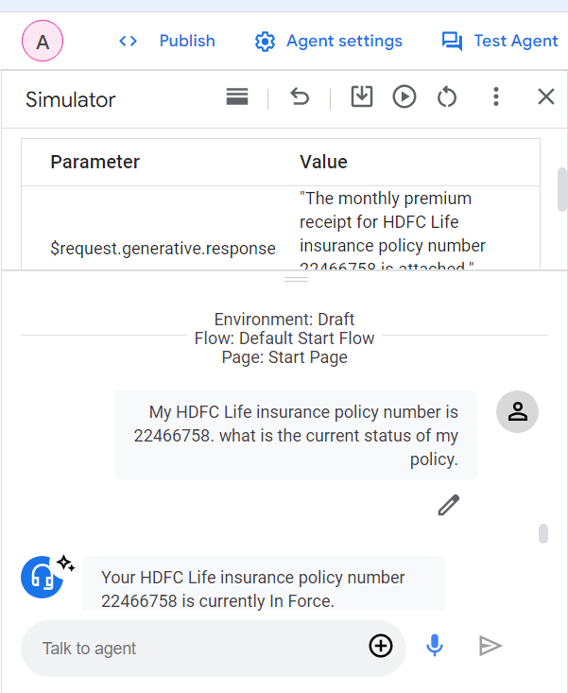
Images of MediBuddy-Vertex-AI-Agent Builder

Slide 8
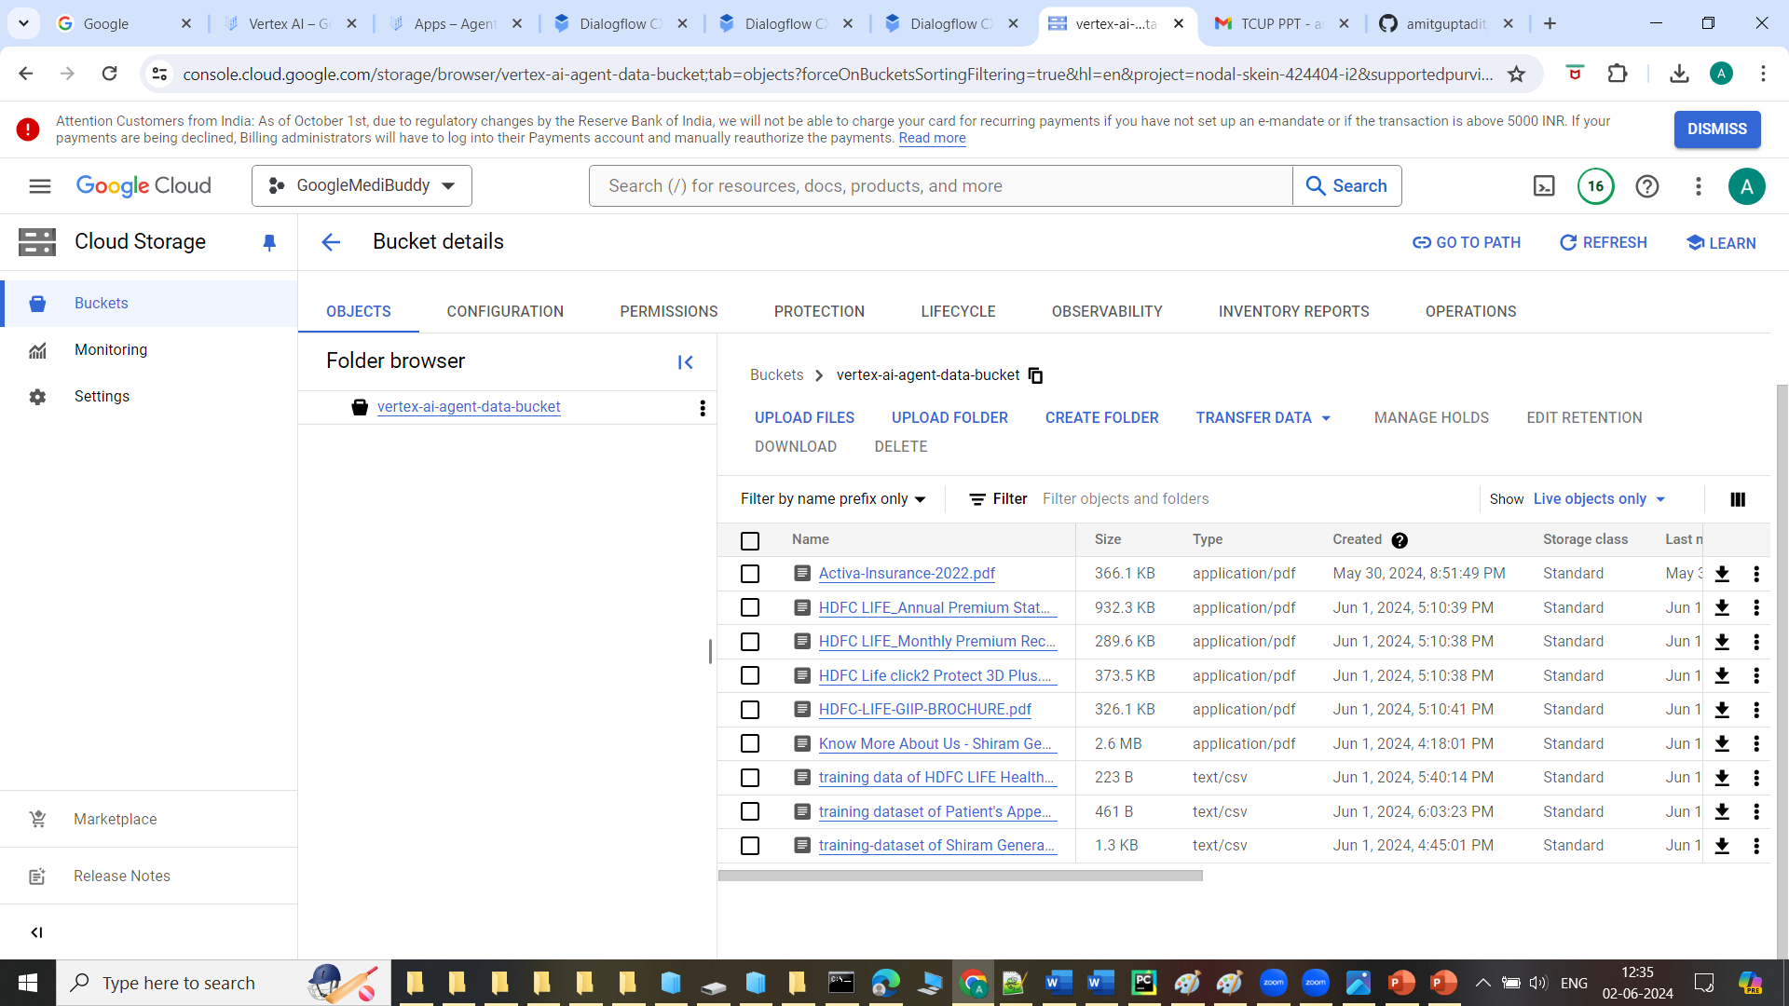
Images of MediBuddy-Vertex-AI-Agent Builder

Slide 9
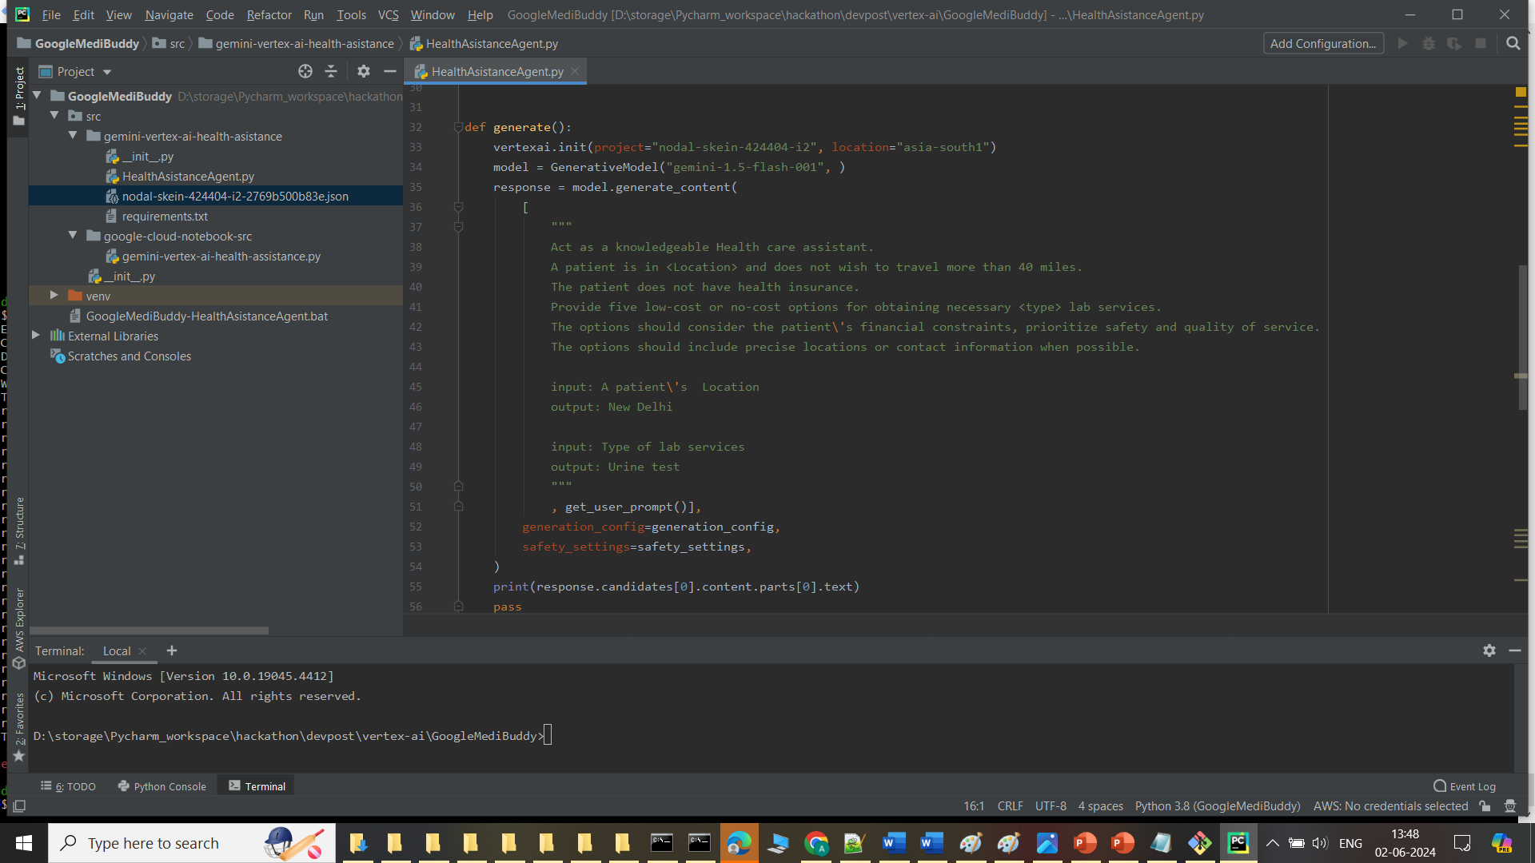
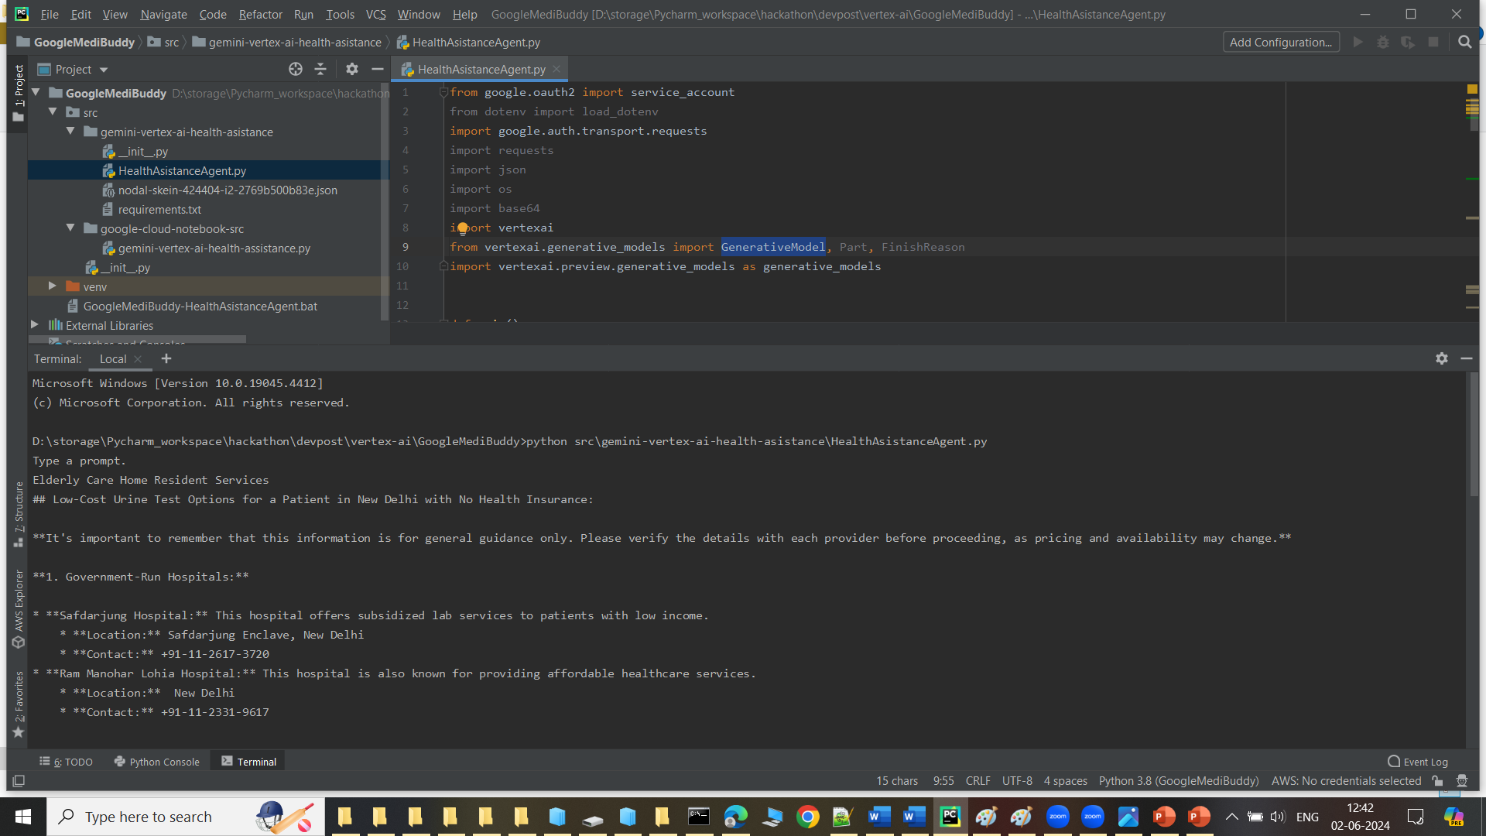
Images of Google Healthcare Assistant Agent

Slide 10
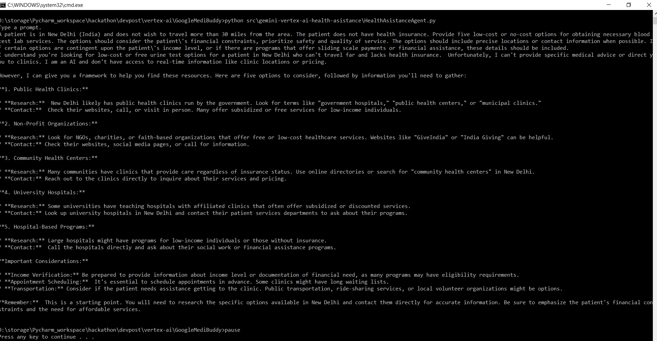
Images of Google Healthcare Assistant Agent

Slide 11
Location for project source code,executable binary ,recording and PPT file for Google Devpost Hackathon events
Github
https://github.com/amitguptadit/GoogleVertexAI-HealthcareAsistanceAgent.git
Executable binary : https://github.com/amitguptadit/GoogleVertexAI-HealthcareAsistanceAgent/blob/main/GoogleMediBuddy/GoogleMediBuddy-HealthAsistanceAgent.bat
Google Cloud Project details
Project name : GoogleMediBuddy
Agent name : MediBuddy-Vertex-AI-Agent Builder
Designed Prompt for my Healthcare Assistant “GoogleMediBuddy” Project
https://console.cloud.google.com/vertex-ai/generative/language/locations/asia-south1/prompts/3802744527547006976?hl=en&project=nodal-skein-424404-i2&supportedpurview=project

Slide 12
Thankyou very much for giving me this wonderful opportunity.
We learnt a lot from this event and also have enjoyed the learnings with this hackathon event.
Again Thank You very much every one for giving us this platform.

